Slide 1
Tutorial 04

Slide 2
Lecture reviews.

Slide 3
Design Techniques
Express all constraints (you can express!).
Use and do not change terminology and class structure of the application domain.
Keep it simple.
Avoid defining entity types that do not serve any purpose.
Don’t use an entity set when an attribute will do. Choose an entity set if it helps expressing constraints; otherwise, use an attribute.
Avoid redundancy (but derived attributes are okay)!
Limit the use of weak entity sets.

Slide 4
Weak Entity Sets
Database design beginners often doubt that any attribute could be a key.
Once there is no solution for a key, they make all entity sets weak, supported by all other entity sets to which they are linked.
In fact, we can artificially create unique IDs for entity sets.
We use weak entity sets only if there is no capability of creating unique IDs.

Slide 5
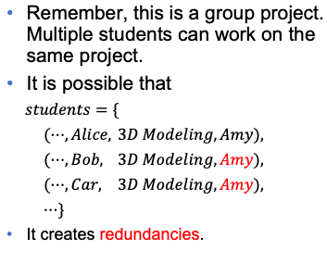
Redundancy Elimination
Suppose we want to model that “each student is doing a group project with a supervisor”.
What is the problem of this design?
Remember, this is a group project. Multiple students can work on the same project.
It is possible that
$students=\{$
$(⋯,Alice,$ $3D Modeling,Amy),$
$(⋯,Bob,$ $3D Modeling,Amy),$
$(⋯,Car,$ $3D Modeling,Amy),$
$⋯\}$
It creates redundancies.
name
id
phone
person
ISA
student
project_name
year
GPA
supervisor
student
project
supervisor

Slide 6
Redundancy Elimination
A better design can be
project_name
supervisor
student
work_on
project

Slide 7
Exercises– Redundancy Elimination
Consider the UIC database that we have been discussed for previous lectures. (The ER diagram is given on the next page.)
Why the entity set transcript is useless?
Transcript is useless because
1) gained units depend on the course enrollment, which can be calculated;
2) transcript id does not present any information.

Slide 8
Lab.
review

Slide 9
Aggregation
Suppose that we want to count the number of different languages.
The aggregation function COUNT can be used.
SELECT COUNT(*) FROM language
“Aggregation” means performing some operations on a group of objects.

Slide 10
GROUP BY
For example, find the number of films for each language. The resulting table has two columns, one for languages, one for the number of films.
Only those films of the same language are in the same group (different language different group).
Then, count the number within each group.
To achieve the grouping, we use GROUP BY.
SELECT language_id, count(film_id)
FROM film JOIN language USING(language_id)
GROUP BY (language_id)
To indicate the result of aggregation of each group, group by attributes are usually selected.

Slide 11
GROUP BY
The GROUP BY clause contains a set of attributes.
Tuples with the same value of all group by attribute(s) are in the same group.
Be careful when the group by attribute is not a key.
Compare the two queries and tell the difference.
SELECT first_name, COUNT(film_id)
FROM actor JOIN film_actor USING(actor_id)
GROUP BY first_name
SELECT actor_id, first_name, COUNT(film_id)
FROM actor JOIN film_actor USING(actor_id)
GROUP BY actor_id
Notes:
这里我们可以看到一个查询有8页，
一个只有6页，这是因为有些人的first name是相通的
所以一些情况下一定要用key来group by

Slide 12
HAVING
Sometimes we need condition checking before and after aggregation functions.
For example, show the actors’ names and the number of Sci-Fi movies played by him/her if the number of Sci-Fi movies is more than 3.
SELECT actor_id,first_name,last_name,COUNT(film_id)
FROM actor JOIN film_actor USING (actor_id)
JOIN film USING(film_id)
JOIN film_category USING(film_id)
JOIN category USING(category_id)
WHERE category.name='sci-fi'
GROUP BY actor_id
HAVING COUNT(film_id)>3;
The query is executed in this sequence.
Combine the tables in FROM clause
Check the condition in WHERE clause
Group tuples
Aggregation function
Check the condition in HAVING clause
Output the selected attributes

Slide 13
Aggregation
Other than COUNT, there are more aggregate functions for different purposes.
MAX: find the maximum value
MIN: find the minimum value
AVG: calculate the average value
SUM: sum up the values

Slide 14
Distinct
We only assume that every country has a city. But a country may have multiple cites.
Those countries will be over counted.
We can use DISTINCT to remove duplications.
SELECT COUNT(DISTINCT country_id)FROM city

Slide 15
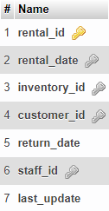
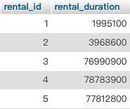
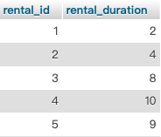
Calculate the average rental duration among all films.
Table: rental
SELECT rental_id, (return_date - rental_date) as rental_duration
FROM rental;
SELECT rental_id, datediff(return_date,rental_date) as rental_duration
FROM rental;
rental_duration = return_date - rental_date

Slide 16
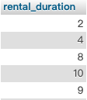
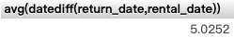
Calculate the average rental duration among all films.
Table: rental
SELECT rental_id, datediff(return_date,rental_date) as rental_duration
FROM rental;
SELECT datediff(return_date,rental_date) as rental_duration
FROM rental;
SELECT avg(datediff(return_date,rental_date))
FROM rental;
rental_duration = return_date - rental_date

Slide 17
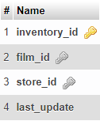
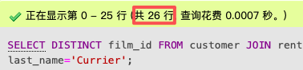
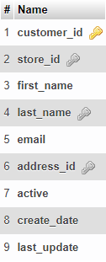
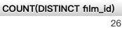
2. Calculate the number of films rented by Norman Currier.
Table: rental
Table: inventory
SELECT DISTINCT film_id
FROM customer
JOIN rental USING(customer_id)
JOIN inventory USING(inventory_id)
WHERE first_name='Norman' AND last_name='Currier';
SELECT COUNT(DISTINCT film_id)
FROM customer
JOIN rental USING(customer_id)
JOIN inventory USING(inventory_id)
WHERE first_name='Norman' AND last_name='Currier';
Table: customer
“Norman”
“Currier”

Slide 18
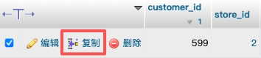
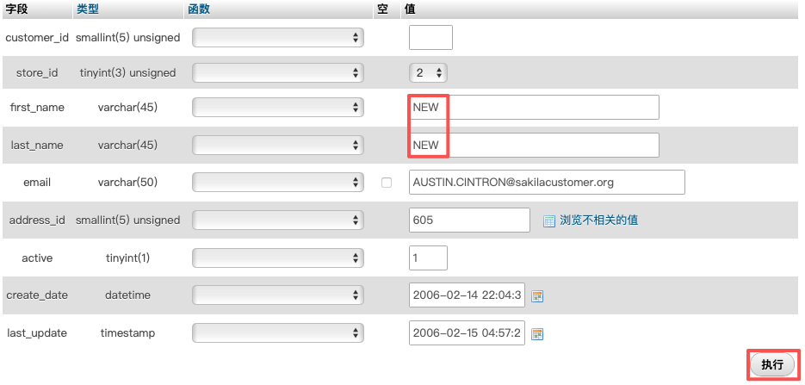
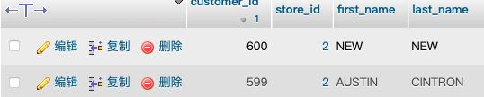
Add a new customer

Slide 19
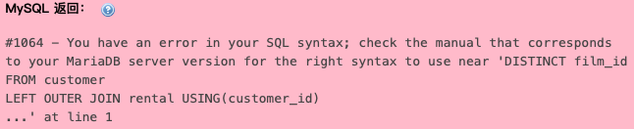
3. Calculate the number of films rented by each customer.
Table: rental
Table: inventory
SELECT customer_id, DISTINCT film_id
FROM customer
LEFT OUTER JOIN rental USING(customer_id)
LEFT OUTER JOIN inventory USING(inventory_id)
Table: customer

Slide 20
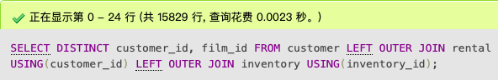
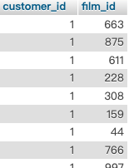
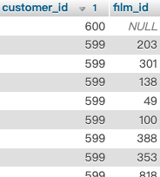
3. Calculate the number of films rented by each customer.
Table: rental
Table: inventory
SELECT DISTINCT customer_id, film_id
FROM customer
LEFT OUTER JOIN rental USING(customer_id)
LEFT OUTER JOIN inventory USING(inventory_id)
Table: customer

Slide 21
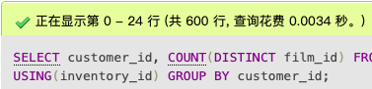
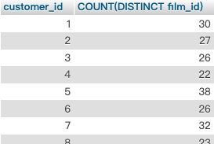
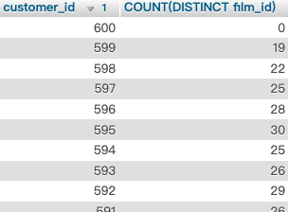
3. Calculate the number of films rented by each customer.
Table: rental
Table: inventory
SELECT customer_id, COUNT(DISTINCT film_id)
FROM customer
LEFT OUTER JOIN rental USING(customer_id)
LEFT OUTER JOIN inventory USING(inventory_id)
GROUP BY customer_id
Table: customer

Slide 22
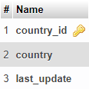
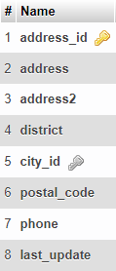
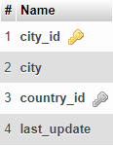
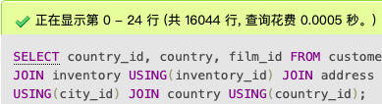
4. Calculate the number of films rented by each group of customers from the same country.
Table: rental
Table: inventory
Table: customer
SELECT
country_id, country, film_id
FROM customer
JOIN rental USING(customer_id)
JOIN inventory USING(inventory_id)
JOIN address USING(address_id)
JOIN city USING(city_id)
JOIN country USING(country_id)
Table: country country
Table: address
Table: city

Slide 23
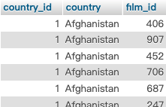
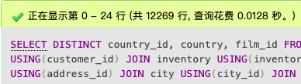
4. Calculate the number of films rented by each group of customers from the same country.
Table: rental
Table: inventory
Table: customer
SELECT
DISTINCT country_id, country, film_id
FROM customer
JOIN rental USING(customer_id)
JOIN inventory USING(inventory_id)
JOIN address USING(address_id)
JOIN city USING(city_id)
JOIN country USING(country_id)
Table: country country
Table: address
Table: city

Slide 24
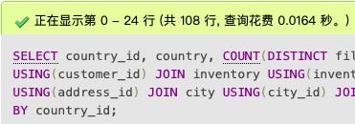
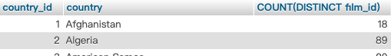
4. Calculate the number of films rented by each group of customers from the same country.
Table: rental
Table: inventory
Table: customer
SELECT country_id, country, COUNT(DISTINCT film_id)
FROM customer
JOIN rental USING(customer_id)
JOIN inventory USING(inventory_id)
JOIN address USING(address_id)
JOIN city USING(city_id)
JOIN country USING(country_id)
GROUP BY country_id
Table: country country
Table: address
Table: city

Slide 25
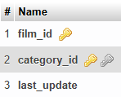
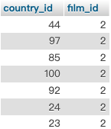
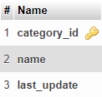
5. Calculate the number of horror films rented by each group of customers from the same country.
Table: rental
Table: inventory
Table: film_catagory
SELECT DISTINCT country_id, film_id
FROM customer
JOIN rental USING(customer_id)
JOIN inventory USING(inventory_id)
JOIN film_category USING(film_id)
JOIN category USING(category_id)
JOIN address USING(address_id)
JOIN city USING(city_id)
JOIN country USING(country_id)
WHERE category.name='horror'
Table: category
Table: customer
“horror”
Table: address
Table: city
Table: country country

Slide 26
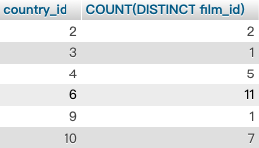
5. Calculate the number of horror films rented by each group of customers from the same country.
Table: rental
Table: inventory
Table: film_catagory
SELECT
country_id, COUNT(DISTINCT film_id)
FROM customer
JOIN rental USING(customer_id)
JOIN inventory USING(inventory_id)
JOIN film_category USING(film_id)
JOIN category USING(category_id)
JOIN address USING(address_id)
JOIN city USING(city_id)
JOIN country USING(country_id)
WHERE category.name='horror'
GROUP BY country_id
Table: category
Table: customer
“horror”
Table: address
Table: city
Table: country country

Slide 27
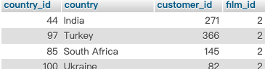
6.Find the countries which have some customers who have rented more than 4 horror films.
Table: rental
Table: inventory
Table: film_catagory
SELECT DISTINCT
country_id, country, customer_id, film_id
FROM customer
JOIN rental USING(customer_id)
JOIN inventory USING(inventory_id)
JOIN film_category USING(film_id)
JOIN category USING(category_id)
JOIN address USING(address_id)
JOIN city USING(city_id)
JOIN country USING(country_id)
WHERE category.name='horror'
>4
Table: category
Table: customer
“horror”
Table: address
Table: city
Table: country country

Slide 28
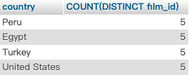
6.Find the countries which have some customers who have rented more than 4 horror films.
SELECT country, COUNT(DISTINCT film_id)
FROM customer JOIN rental USING(customer_id)
JOIN inventory USING(inventory_id)
JOIN film_category USING(film_id)
JOIN category USING(category_id)
JOIN address USING(address_id)
JOIN city USING(city_id)
JOIN country USING(country_id)
WHERE category.name='horror'
GROUP BY customer_id
HAVING COUNT(DISTINCT film_id)>4
Table: rental
Table: inventory
Table: film_catagory
>4
Table: category
Table: customer
“horror”
Table: address
Table: city
Table: country country

Slide 29
Q&A

